Slide 1
PDAT613G: Data Mining
Module 3C – Ethics

Slide 2
55 – Ethical considerations are important in all stages of data science work.
Choosing what to analyze.
Choosing who will do the analysis.
Collecting data.
Analyzing data.
Creating algorithms/predictive models/data science products.
Using and communicating the output of data science products.
An Ethical Checklist for Data Science (uchicago.edu)

Slide 3
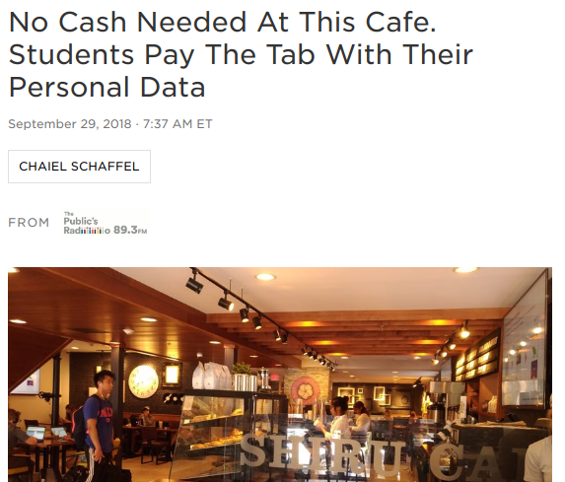
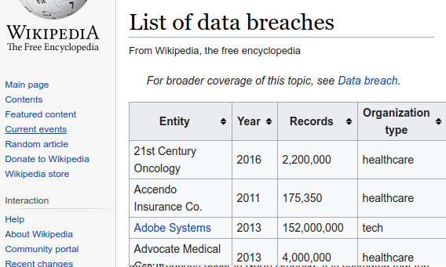
56 – Data Collection and Data Breaches
How is consent given for data collection?
Who owns collected data?
How are the risks of a data breach addressed?
Are others held to the same standards in safeguarding data?

Slide 4
57 – Personally Indentifying Information
Personally identifying information includes name, date-of-birth, social security number, certain medical and credit records, etc.
When possible, it’s desirable to store data with personally-identifying information removed.
The push in today’s world seems to be toward greater use of more and more targeted data.
To what extent can you as a data scientist store as little information as possible to do what you need to do–using that information only for the purpose it was given?
When making that decision, it’s important to realize that statistical techniques make it relatively easy to reconstruct identities from relatively few pieces of seemingly anonymous information.

Slide 5
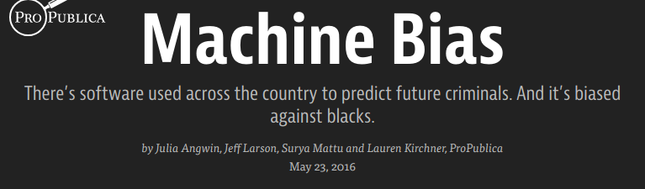
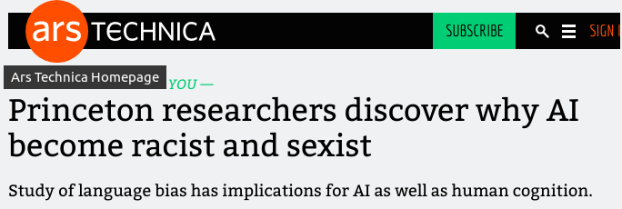
58 – Are algorithms better than human judgement?
How are algorithms trained? If trained with biased data, do they deliver biased results?
If your fate is decided by an algorithm, do you have a right to inspect the code?
Should the creator of a data science product foresee the ways in which that product might be misused?
How can problems be avoided in the development process?

Slide 6
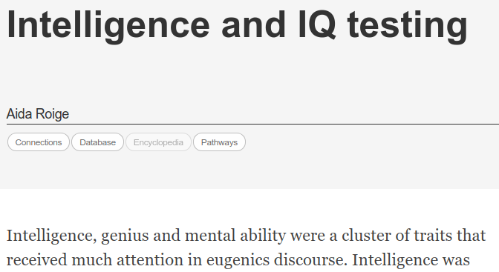
59 – Who is responsible for the eventual use of a data science product?
Tension between the intent and eventual use of a data science product is not new.
The Binet-Simon intelligence test was developed in France in the early 1900’s as a way to identify and help struggling students.
It was later adopted by the eugenics movement in the United States as a means to promote their agenda.

Slide 7
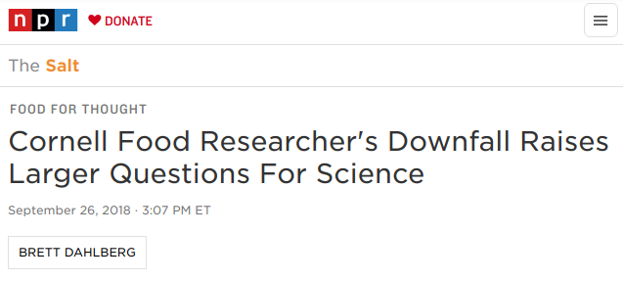
60 – p-Hacking refers to unethically altering a data set or analysis technique to obtain a desired result.
Hypotheses and testing techniques should ideally be set in the design phase before data is collected–not altered in light of what has been found in the data.
Running multiple tests in the hope of finding one significant result is bad statistical practice, unless appropriate adjustments for multiple testing are done.
If your desired significance level is alpha, and you run n tests, the conservative Bonferroni correction would require that a result be found significant at the (alpha/n) significance level in order to report a discovery.

